Slide 1
Pre-processing of Hyperspectral Images
Pre-processing of EO1 Hyperion images and displaying Hyperion images in RGB colour format using MATLAB.
By:
Cyan Subhra Mishra
cyanmishra92@gmail.com

Slide 2
Presentation Outline
Introduction
Technical details of Hyperion images
Steps in Pre-processing
Pre-processing using MATLAB
A comparison between ENVI and MATLAB outputs
Conclusion

Slide 3
INTRODUCTION
Introduction
Objective of the project

Slide 4
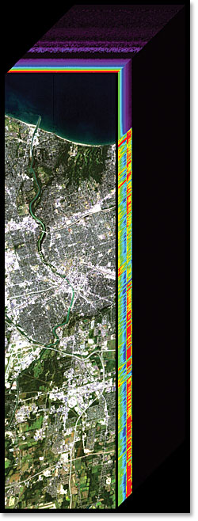
Introduction
Images with wide band range : takes image in 100s of bands.
Usually in IR region.
Data stored as hyperspectral data cube.
Several satellite sensors – e.g. ARIES, AVIRIS, Hyperion, HyMap etc.
High spectral resolution – better results in classification and target detection
Highly used for Agriculture, Mineralogy, Surveillance, Military etc.
Sample data for study – Hyperion sensor of EO – 1 by NASA.

Slide 5
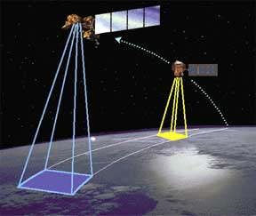
Objective of Project
Satellites take image from great heights
Data compromised by lighting, atmosphere, weather etc.
Requirement of pre-processing
Correction and noise removal
Data redundancy – Dimensionality reduction
Time complexity reduction – Improved processing
Increased accuracy and efficiency due to radiometric correction
Software used – ENVI; costs more than 4 lacs – thus development of open source platform using MATLAB.

Slide 6
TECHNICAL DETAILS OF HYPERION IMAGES
Technical Details Of Hyperion Images

Slide 7
Technical Details Of Hyperion Images
Part of EO – 1 mission in 2001
Sensor altitude – 705km.
Orbit inclination – 98.9⁰
Velocity – 6.74km/s
Swath – 7.5km
Spectral bands – 242 (0.4 to 2.5 micron)
Spatial resolution – 30m
Data format used – level 1 data (.L1R) organised in BIL format
Data type – 16 bit signed integer in BE format

Slide 8
STEPS IN PRE-PROCESSING
Reading Level 1 data
Dark pixel subtraction
Bad band removal
Radiometric correction
MNF
PPI

Slide 9
Steps In Pre-processing
Reading level 1 data
Dark pixel subtraction
Bad band removal
Radiometric correction
MNF
PPI

Slide 10
Reading Level 1 Data
Extension .L1R.
Can be read by ENVI software by its load image command.
MATLAB use multibandread command of hyperspectral toolbox:
X = multibandread(FILENAME, SIZE, PRECISION, OFFSET, INTERLEAVE, BYTEORDER)
The required data (e.g. size, precision, interleave etc.) can be availed through the header file (extension .hdr).

Slide 11
Dark Pixel Subtraction
Data stored as 16 bit signed integer.
Negative pixels – no information; needed to be removed.
Translating pixel values.
Least valued pixel gets zero (0) value.
May not be accurate – least value may not be zero, but necessary.
Data comparison can not be detected by naked eye.
Algorithm for dark pixel subreaction:
While i <= number_of_bands
min(i) = min(min(image(:; :; i)));
img_darkpix_sub(:; :; i) = image(:; :; i) - min(i);
i + +;
end;

Slide 12
Bad Band Removal
Several not calibrated bands – gives fake data or no data.
According to EO – 1 user guide: Calibrated channels are 8-57 for the VNIR, and 77-224 for the SWIR.
Bands wit low detector response are not calibrated.
Apart from those 8 to 12, 59 to 63 and 77 to 81 are sparse matrices – with all zeros.
ENVI does not remove the above (sparse) bands.

Slide 13
Radiometric Correction
Step 1
Step 2
Radiance
Step 3
Exo-atmospheric reflectance
Step 4
Step 5
On ground reflectance
Digital numbers
Atmospheric correction

Slide 14
Conversion of Digital Number to Radiance
Data recorded in files are 16 bit digital values recorded at sensors.
Band 1 to 70 belongs to the VNIR, and band number 71 to 242 belongs to the SWIR.
Scaling factor:
VNIR – 40
SWIR – 80
Unit - W/m² SR μm
Digital number to radiance:
VNIR L = Digital Number / 40
SWIR L = Digital Number / 80

Slide 15
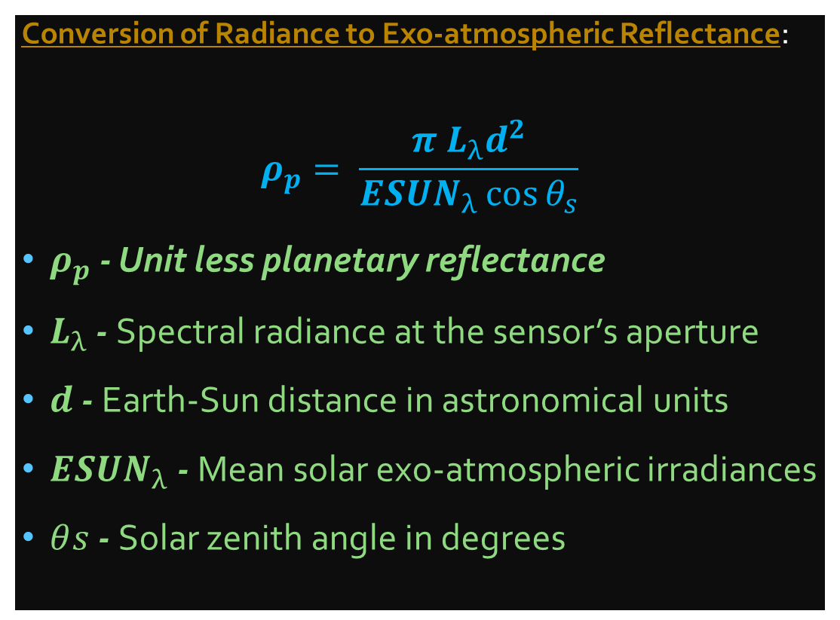
Conversion of Radiance to Exo-atmospheric Reflectance
Conversion of Radiance to Exo-atmospheric Reflectance:
$$ρ_{p}= \frac{π L_{λ}d^{2}}{{ESUN}_{λ}\cos{θ_{s}}}$$
$ρ_{p}$ - Unit less planetary reflectance
$L_{λ}$ - Spectral radiance at the sensor’s aperture
$d$ - Earth-Sun distance in astronomical units
${ESUN}_{λ}$ - Mean solar exo-atmospheric irradiances
$θ﷮s$ - Solar zenith angle in degrees
A reduction in between-scene variability can be achieved through a normalization for solar irradiance by converting spectral radiance to planetary reflectance or albedo.
The data required to find reflectance are available in metadata files (extension .met)

Slide 16
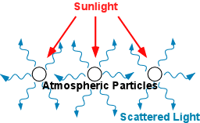
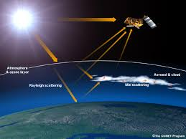
Atmospheric Correction
Gasses and aerosol present in the atmosphere puts some effect on the data acquisition.
Scattering of sunlight due to CO2 and water vapour.
Several atmospheric models have been made to realise the true atmosphere.
The atmospheric models are too complicated to translate into simple lines of codes.
There are several software like FLAASH, ATCOR are being used for this purpose.

Slide 17
Minimum Noise Fraction
Introduced by Green et al.
MNF transform takes linear transformations which maximise SNR.
Two cascaded PCAs – of original image & decorrelated image.
Invariant to non-singular linear transformations of the data.
Use of MNF:
to determine the inherent dimensionality of image,
to segregate noise in the data
to reduce the computational requirements.

Slide 18
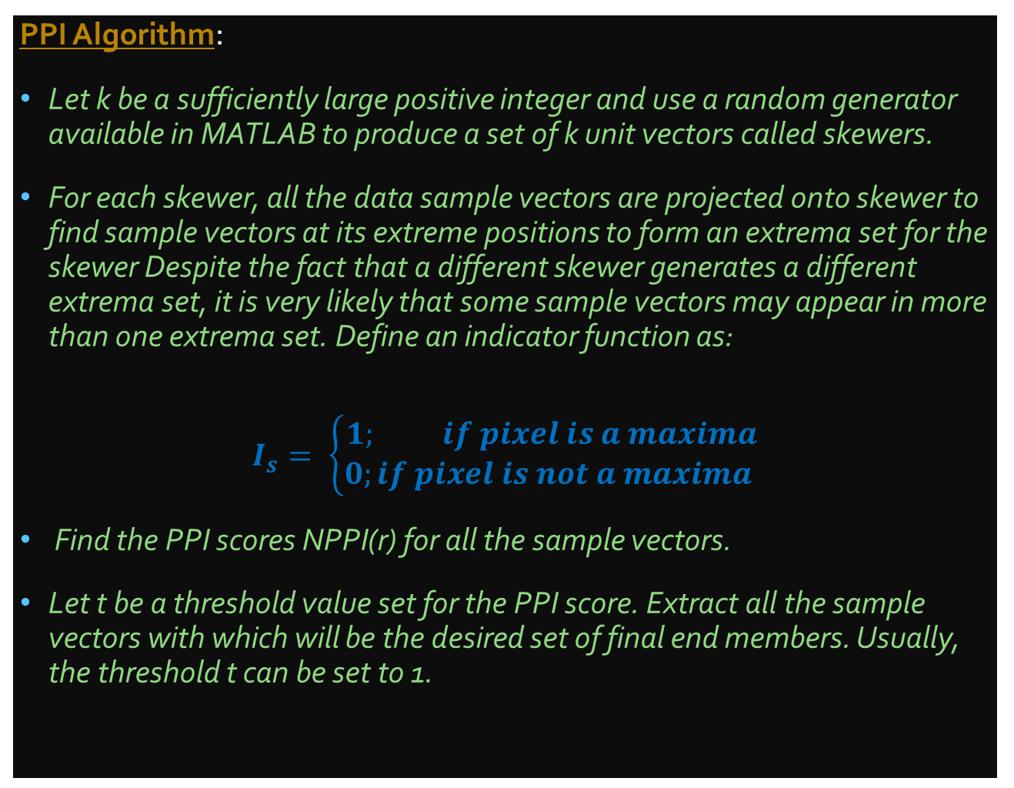
Pixel Purity Index
PPI Algorithm:
Let k be a sufficiently large positive integer and use a random generator available in MATLAB to produce a set of k unit vectors called skewers.
For each skewer, all the data sample vectors are projected onto skewer to find sample vectors at its extreme positions to form an extrema set for the skewer Despite the fact that a different skewer generates a different extrema set, it is very likely that some sample vectors may appear in more than one extrema set. Define an indicator function as:
$$I_{s}= \left\{\begin{aligned}1; if pixel is a maxima \\ 0;if pixel is not a maxima \end{aligned}\right.$$
Find the PPI scores NPPI(r) for all the sample vectors.
Let t be a threshold value set for the PPI score. Extract all the sample vectors with which will be the desired set of final end members. Usually, the threshold t can be set to 1.
Hyperspectral sensors have a low spatial resolution – Hyperion 30m.
Each pixel is a mixture of different classes of objects.
Important to find pure pixel – pixel with only one class.

Slide 19
DISPLAY OF IMAGE
Grayscale display
Rgb display
Vegetation & Swir display

Slide 20
Grayscale Display
A grayscale image - Band 40; VNIR corresponds to 753 nm.
When reviewing single bands, streaks in the vertical direction may be noticed. The phenomena are caused by a variation in the calibration of the pixels in the cross-track direction.

Slide 21
RGB Display
The visible range falls in the VNIR region.
For a standard colour image the CIE (International Commision on Illumination) has decided the RGB wavelengths as 700nm for red, 546.1nm for green and 435.8nm for blue, which corresponds to band 38 for red, 21 for green and 9 for green.
Thus to obtain a colour image of the scene that represents true RGB the bands 29 : 23 : 16 for R : G : B are typically used - approximate wavelengths of 641 nm, 580 nm and 509 nm.

Slide 22
Vegetation and SWIR RGB
To obtain a colour image of the scene in which vegetation appears red, bands 50 : 23 : 16 can be selected - 855 nm, 580 nm and 509 nm.
To obtain a colour image of the SWIR, bands 204 : 150 : 93 for R:G:B is a usable combination - 2194 nm, 1649 nm and 1074 nm

Slide 23
A COMPARISON BETWEEN MATLAB & ENVI

Slide 24
ENVI RGB
MATLAB - RGB
MATLAB Vegetation
MATLAB SWIR RGB

Slide 25
CONCLUSION
Conclusion
Future scope of project

Slide 26
Conclusion
Hyperspectral image analysis is a very important tool and can
open many gates in the fields of agriculture, target detection, military
application, mining and many more. The EO-1 data being open source
are very handy for researchers for analysis purpose. But the only
problem in EO-1 hyperion image is its low spatial resolution.

Slide 27
Scope of the Project
The target of the project was to create a open source hyperspectral analysis tool in MATLAB. Though the complete target is yet to be achieved, but a very important part of the target is complete and giving promising results. A software based approach in this field may help in developing a small open source package for analysis of Hyperion images. Similarly an analytical approach towards this project may solve the complicacy involved in atmospheric correction, PPI, ICA and many other fields. At the end it can be concluded that the research in the field of hyperspectral imaging is a multidisciplinary research task and should be encouraged in under graduate student level.

Slide 28
References :
EO – 1 / Hyperion Science Data User Guide – by Pamela Barry the Hyperion performance and analysis team lead
EO – 1 User Guide – by Dr Richard Beck, Department of Geology, University of Cincinnati, Ohio.
PPI based end member extraction algorithm – by Chaudhry et al.
Transformation for Ordering Multispectral Data in Terms of Image Quality with Implications of Noise Removal – Green et al. 1988
A First Course in Linear Algebra – by Robert A. Beezer

Slide 29
THANK YOU

